Slide 1
DESIGN OF PRISMATIC BEAMS FOR BENDING
Chapter 5 Problems (5.65, 5.66, 5.69, 5.70, 5.73)

Slide 2


Slide 3
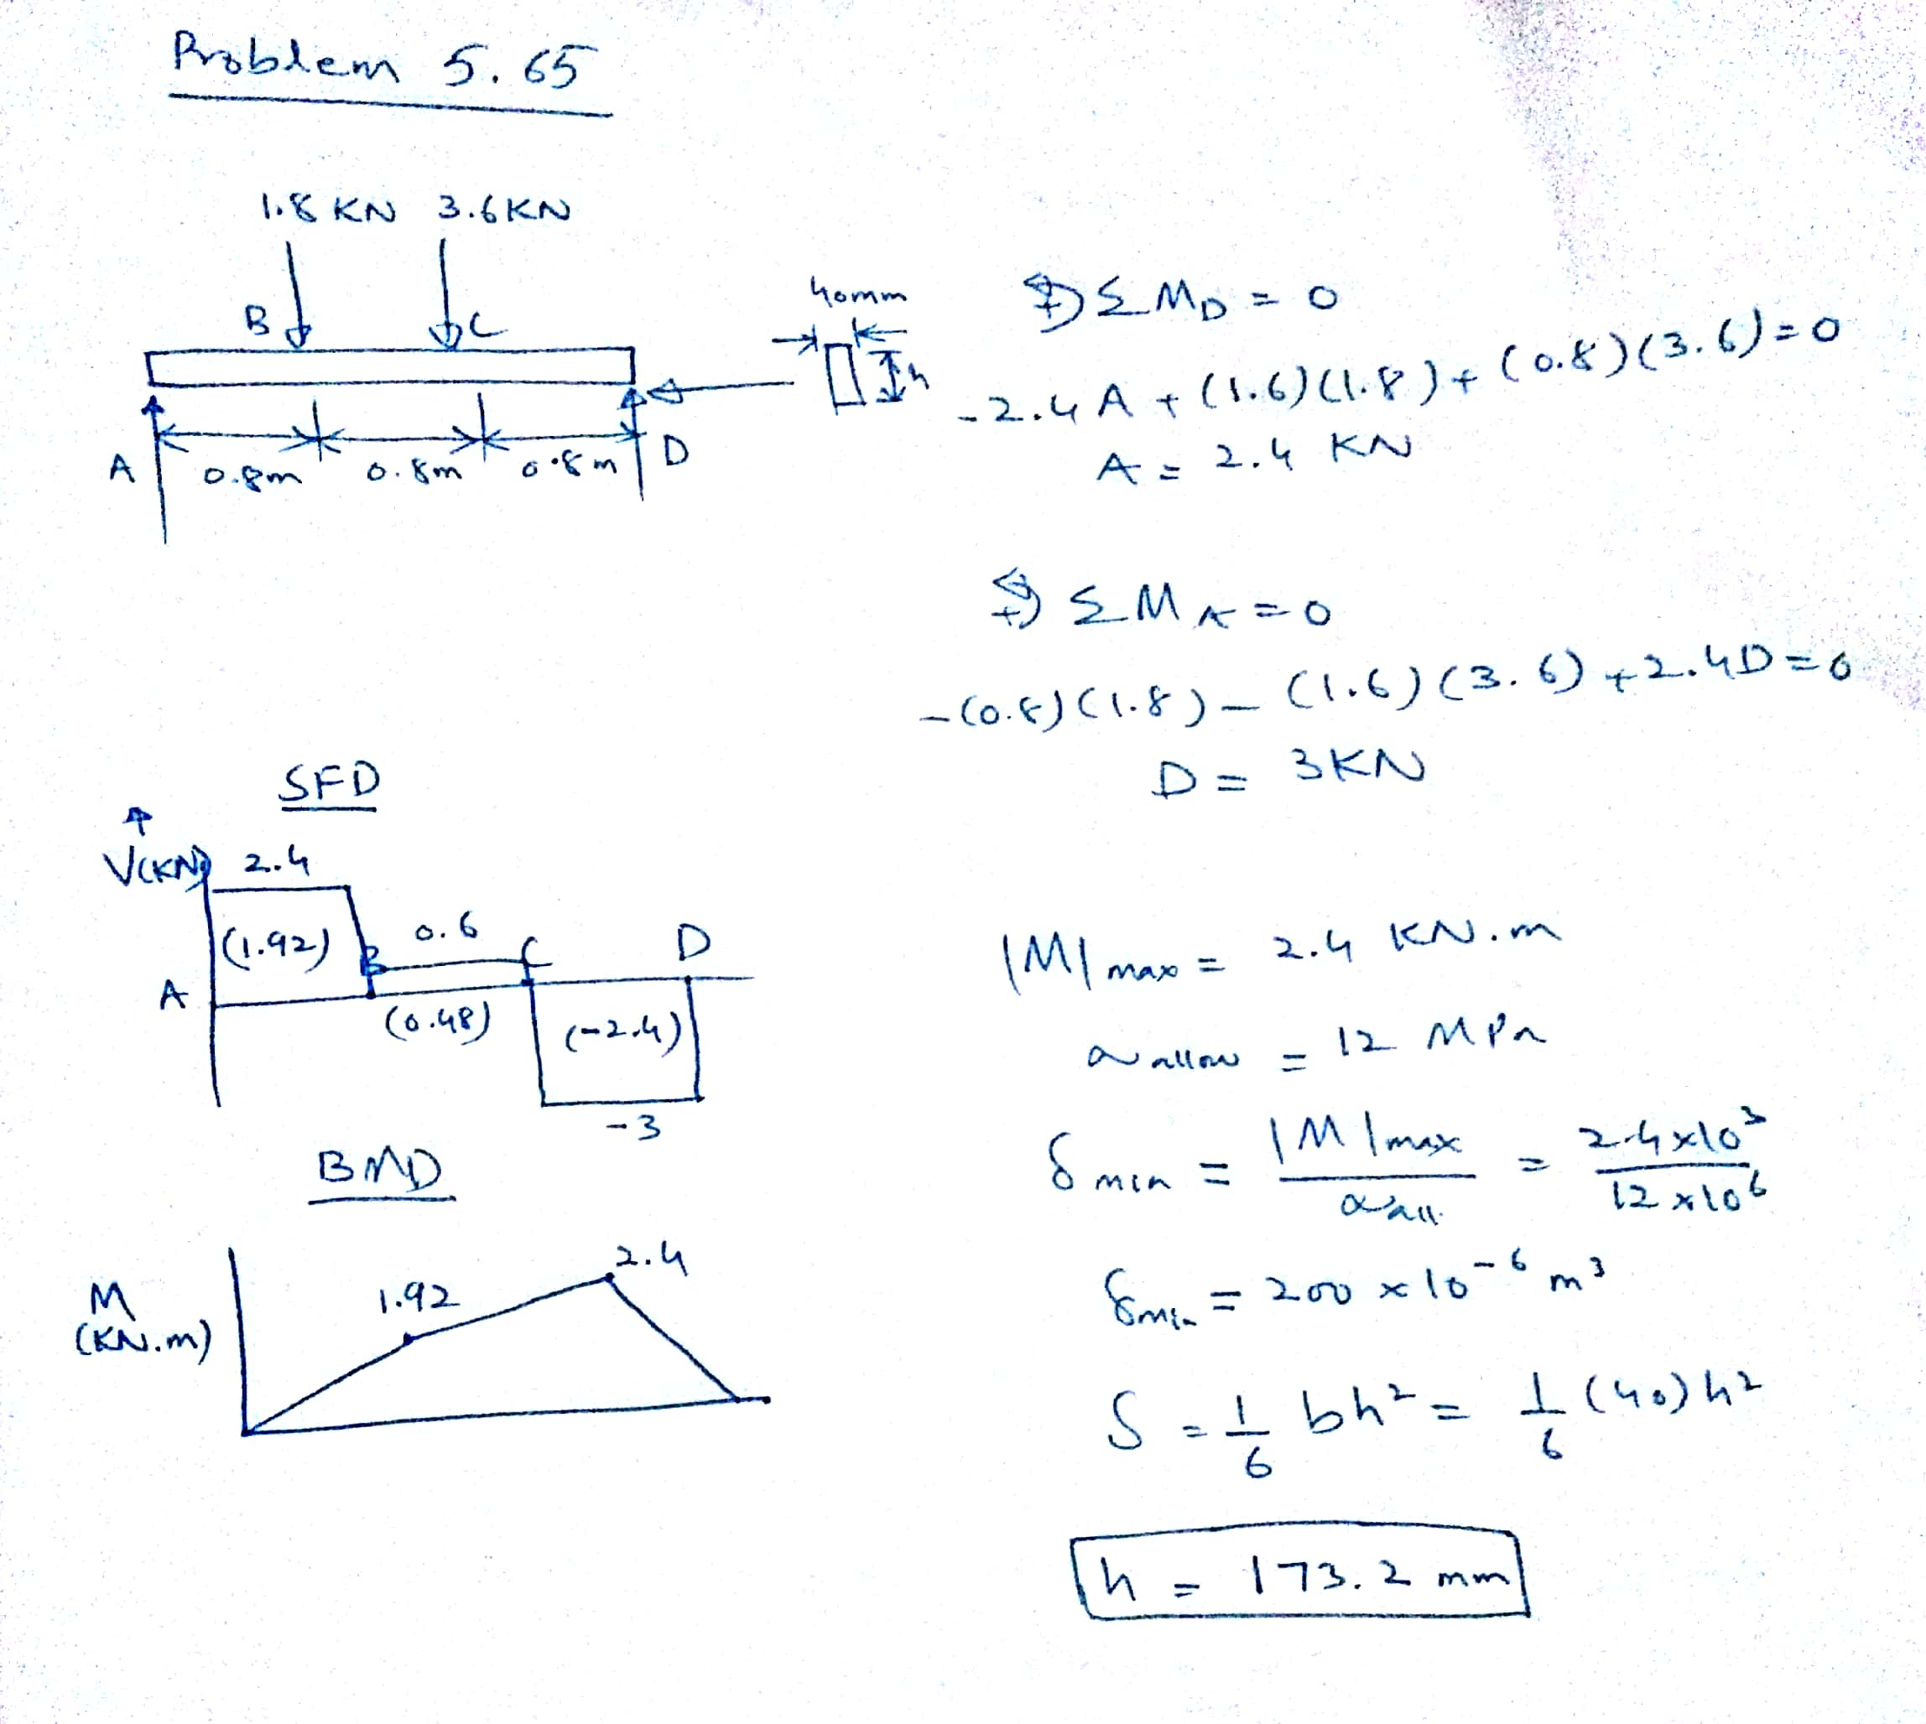

Slide 4
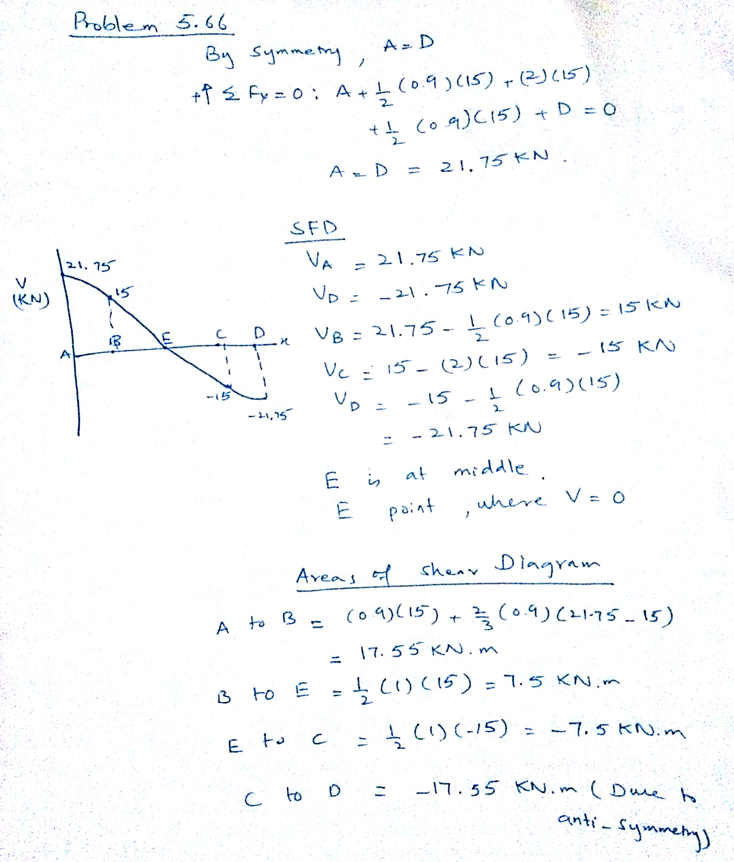

Slide 5
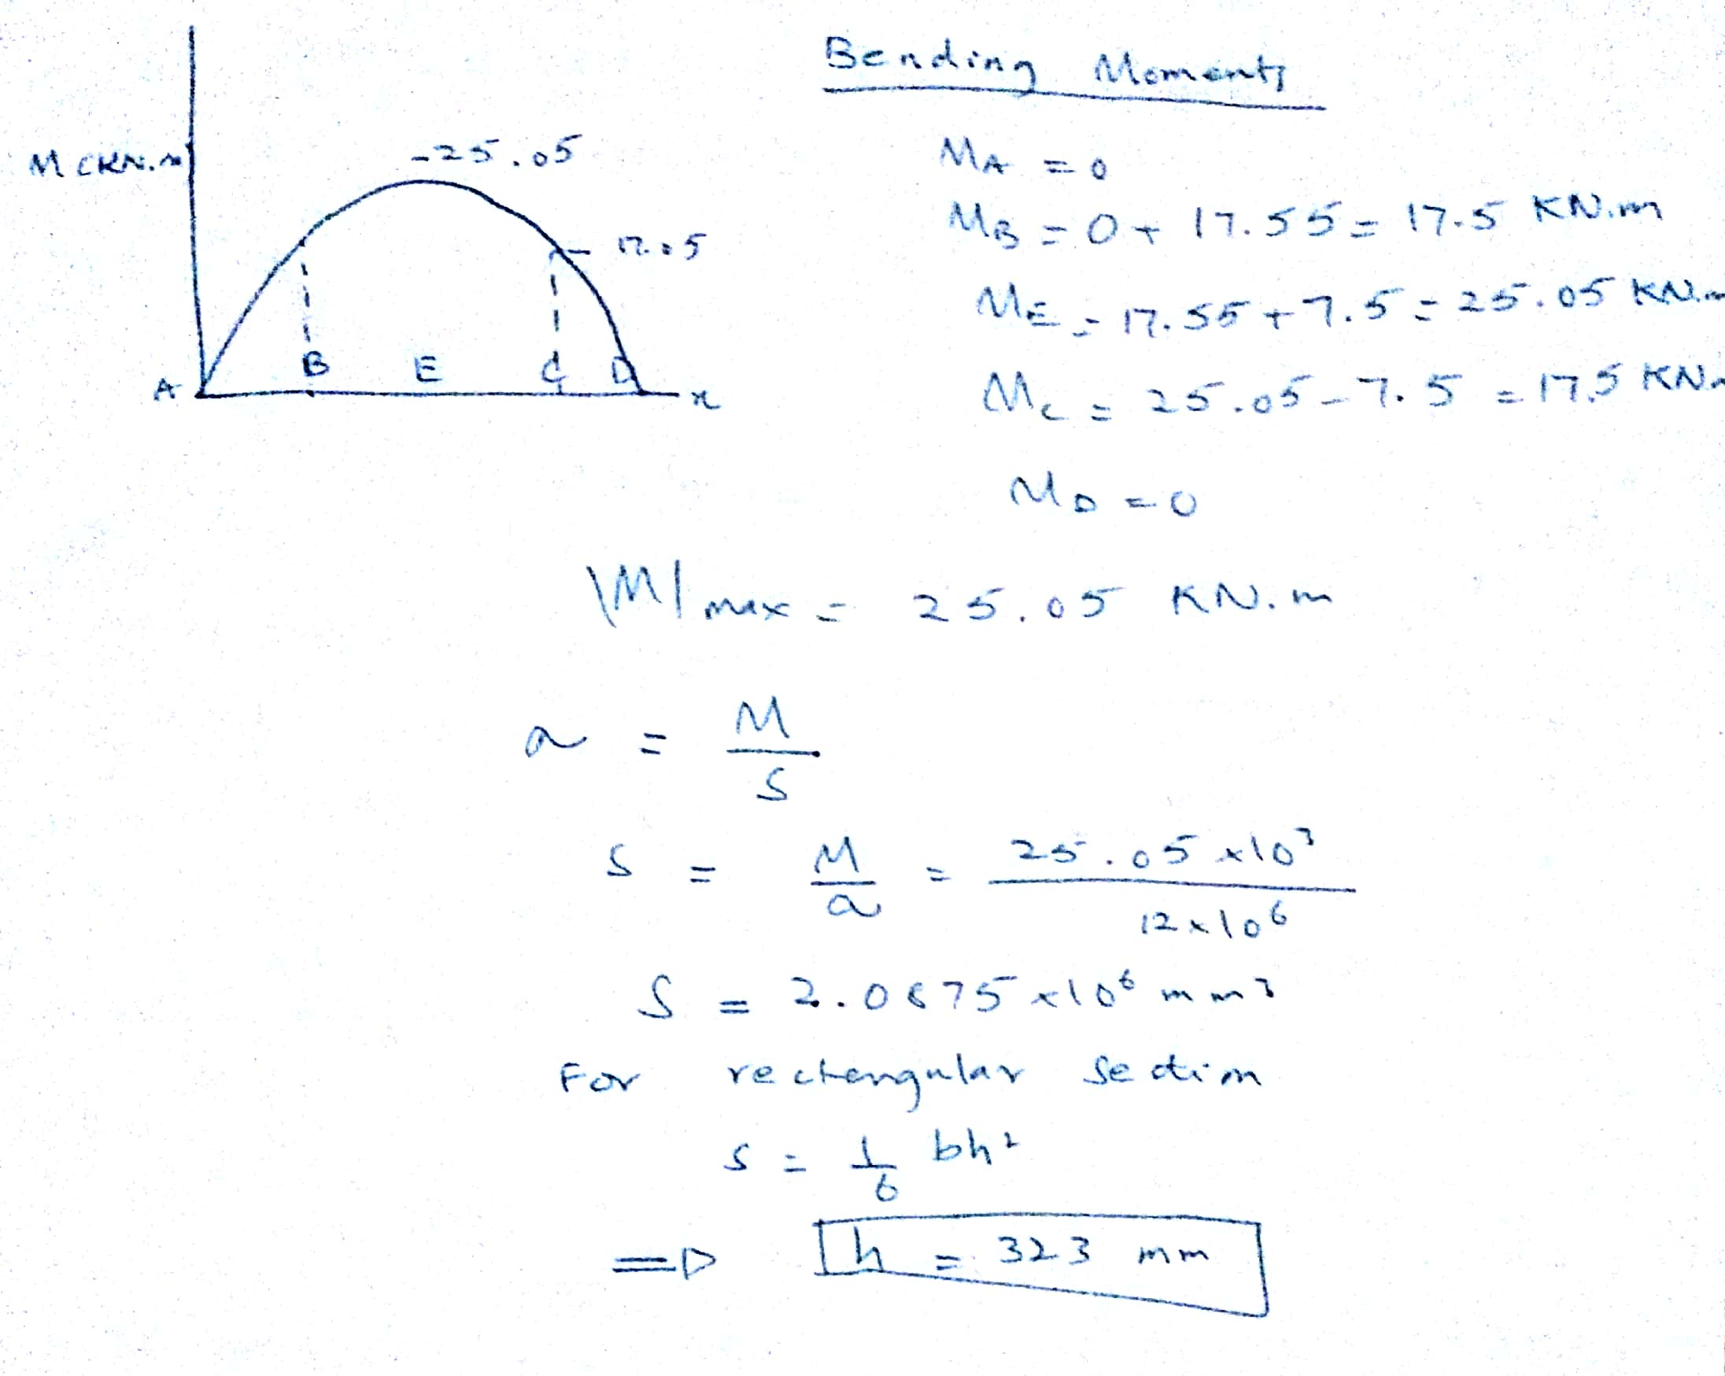

Slide 6


Slide 7
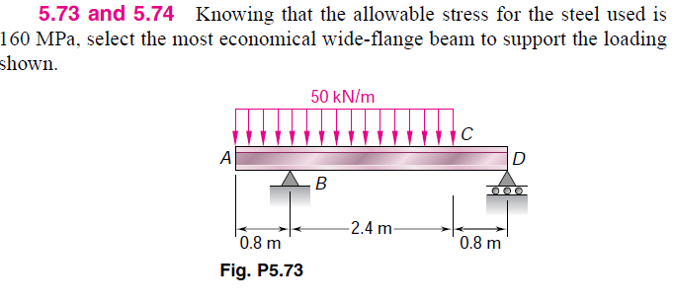

Slide 8
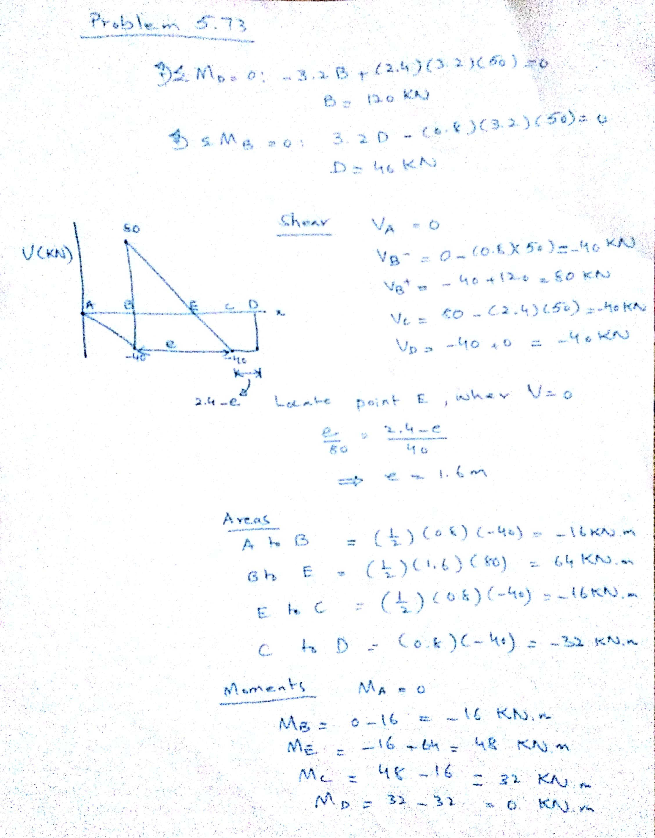

Slide 9
